Slide 1


Heart Disease Prediction Milestone - 3
GROUP 1
LAMIA ALSHAHRANI
DHARITRI RATHOD
ANWESH PRAHARAJ
SYED MUHAMMAD SABIH

Slide 2

Project Statement
For the Heart Disease Dataset, we want to classify the presence of heart disease using the best combinations of the dataset files (Cleveland, Hungarian, Switzerland, VA) based on the most relevant patient attributes.

Slide 3
The Dataset
UCI Repository- Link to Dataset
Database contains 76 features (All published experiments refer to 14 of them).
4 datasets: Cleveland, Hungarian, Switzerland, and VA.
Researchers have used Cleveland Dataset to this date.
14 variables are: Input: age, sex, cp, trestbps, chol, fbs, restecg, thalach, exang, oldpeak, slope, ca, and thal Output: num.
Notes:
This database contains 76 attributes, but all published experiments refer to using a subset of 14 of them. In particular, the Cleveland database is the only one that has been used by ML researchers to
this date. The "goal" field refers to the presence of heart disease in the patient. It is integer valued from 0 (no presence) to 4. Experiments with the Cleveland database have concentrated on simply attempting to distinguish presence (values 1,2,3,4) from absence (value 0).
Description of 13 Input variables
Age: age of the patient
Sex:
0: Female
1: Male
Chest Pain Type (cp):
0: Typical Angina
1: Atypical Angina
2: Non-Anginal Pain
3: Asymptomatic
Resting Blood Pressure: Person's resting blood pressure(trestbps).
Cholesterol (chol): Serum Cholesterol in mg/dl
Fasting Blood Sugar (fbs):
0:Less Than 120mg/ml
1: Greater Than 120mg/ml
Resting Electrocardiographic Measurement(restecg):
0: Normal
1: ST-T Wave Abnormality
2: Left Ventricular Hypertrophy
Max Heart Rate Achieved (thalch): Maximum Heart Rate Achieved
Exercise Induced Angina (exang):
1: Yes
0: No
ST Depression (oldpeak): ST depression induced by exercise relative to rest. Slope: Slope of the peak exercise ST segment (slope):
0: Upsloping
1: Flat
2: Downsloping
Thalassemia (thal): A blood disorder called 'Thalassemia' :
0: Normal
1: Fixed Defect
2: Reversible Defect
Number of Major Vessels (ca): Number of major vessels colored by fluoroscopy.
** 1 Output variables:** num: diagnosis of heart disease (angiographic disease status):
0- < 50% diameter narrowing
1- > 50% diameter narrowing

Slide 4


Procedure
Decided to test different combination of databases rather than only using the Cleveland dataset.
Imputing missing values.
Results would show if we can achieve better results for classification.

Slide 5
Exploratory Data Analysis

Slide 6
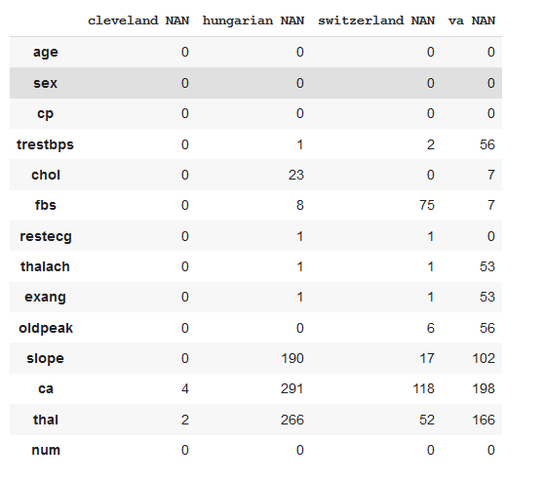
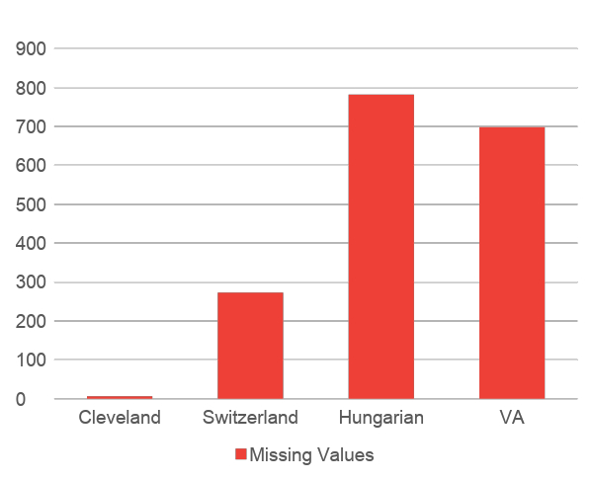
Missing values in the datasets
PYTHON OUTPUT
VISUALIZATION

Slide 7
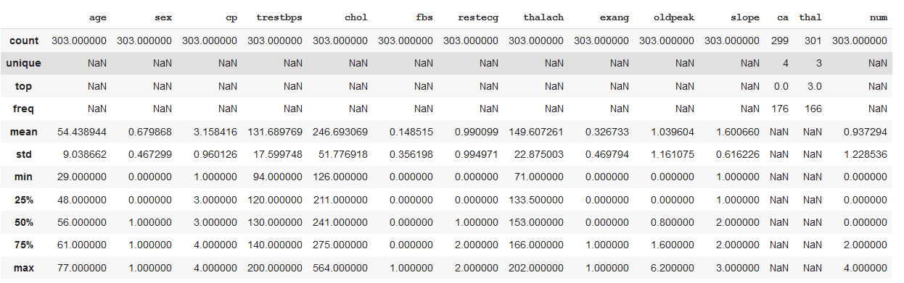
Descriptive Statistics of each dataset
Descriptive statistics of each feature in all 4 datasets were produced to identify type errors or zero rows.
Cleveland

Slide 8
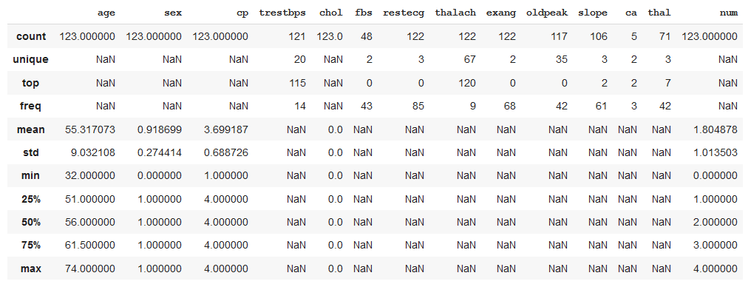
Descriptive Statistics of each dataset continued...
Switzerland

Slide 9
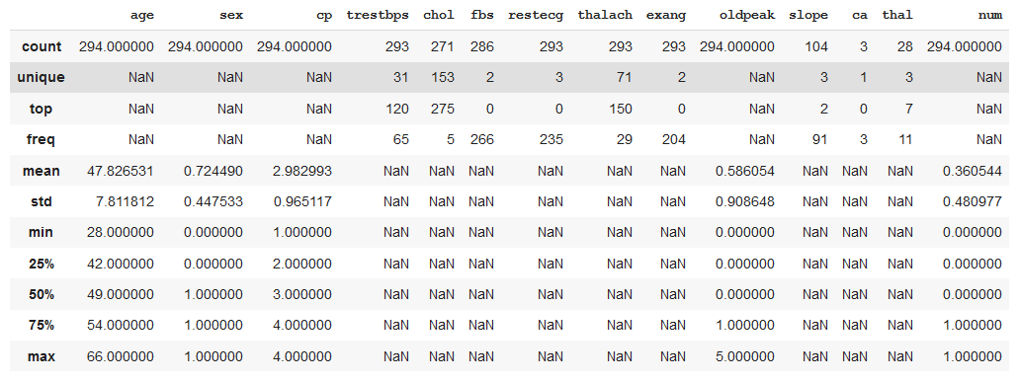
Descriptive Statistics of each dataset continued...
Hungarian

Slide 10
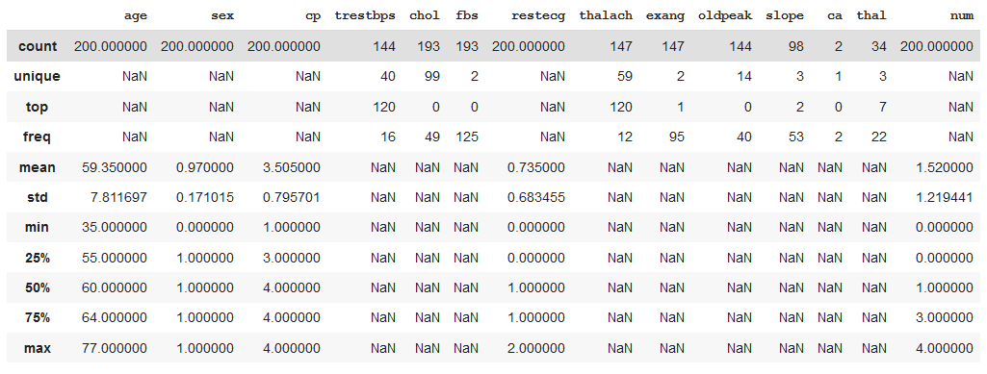
Descriptive Statistics of each dataset continued...
VA
No errors were found.

Slide 11
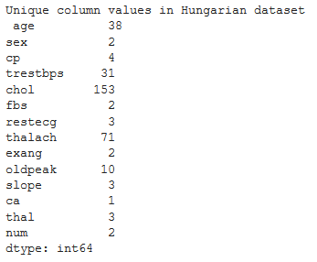
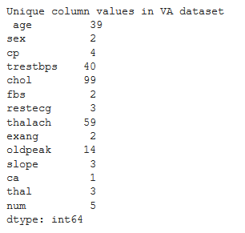
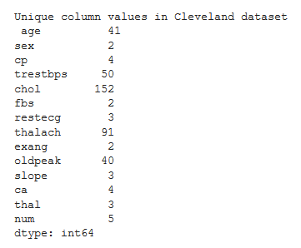
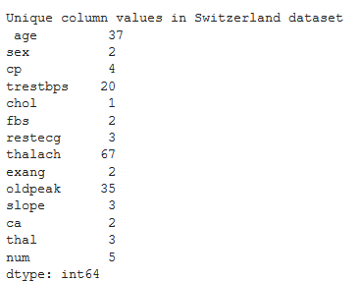
Checking for redundancy within the datasets
Next step was to look for redundancy in columns/features within the datasets.
Cleveland
Switzerland
Hungarian
VA
No column had only one value and the columns with more than one values were categorical variables.

Slide 12
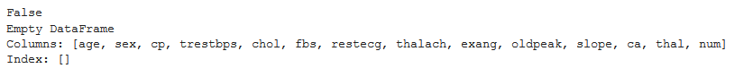
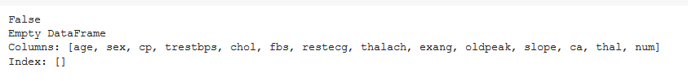
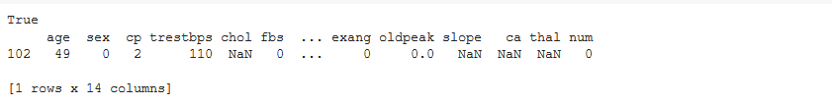
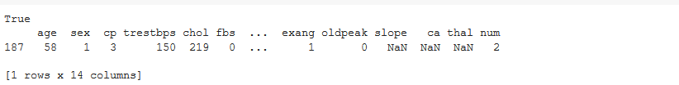
Checking for redundancy within the datasets continued...
Next step was to look for redundancy in rows within the datasets.
Cleveland
Switzerland
Hungarian
VA
Duplicate values might exist due to the missing values.

Slide 13
Imputing the missing values
Before proceeding further in the EDA, imputing values was necessary.
Procedure:
The 5 combinations of datasets that we decided to use were: Cleveland, Hungarian, Switzerland, and VA Cleveland, Hungarian Cleveland, Switzerland Cleveland, Hungarian, and Switzerland Cleveland (For comparison with other combinations)
The Imputation methods we decided to use on the combinations were: KNN Imputer - Odd k values ranging 1 through 50 Iterative Imputer - Order = ascending, descending, roman, arabic, and random
Other changes made to the data for imputation: The inputs were normalized using MinMax Scaler The Target variable was changed to binary (0: Absence of heart disease, 1: Presence of heart disease)
Evaluation methods to see which combination has a better accuracy score: Model used: RandomForestClassifier – default Cross Validation: RepeatedStratifiedKFold - 10 folds, repeated 3 times, with a random state of 1

Slide 14
Imputing the missing values continued...
Cleveland, Hungarian, Switzerland, and VA
KNN Imputer
Cleveland, Hungarian
Cleveland, Switzerland
Cleveland, Hungarian, and Switzerland
Cleveland (For comparison with other combinations)
Input:MinMaxScaler
Output: Binary conversion
RESULTS
Cleveland, Hungarian, Switzerland, and VA
Cleveland, Hungarian
Cleveland, Switzerland
Iterative Imputer
Cleveland, Hungarian, and Switzerland
Cleveland (For comparison with other combinations)

Slide 15
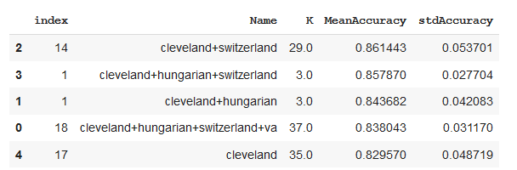
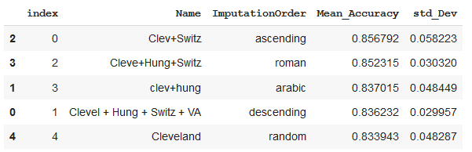
Imputing the missing values continued...
Results of the Imputation – Best hyperparameters chosen based on scores.
KNN
Iterative
Method of Imputing chosen: KNN (K=3) on the combination of Cleveland, Switzerland, and Hungarian datasets.
Final dataset was produced for experiment.

Slide 16
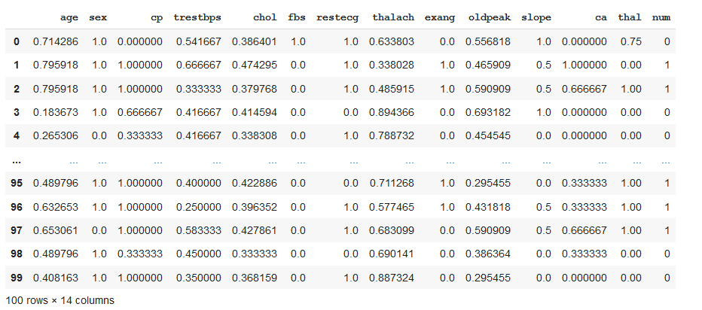
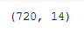
Analysis of the Imputed dataset (Final Dataset)
Top 100 rows of the Final Dataset were produced to visualize the scaled and imputed data.
Shape of the data was produced.

Slide 17
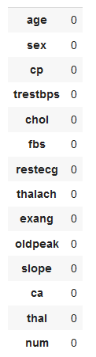
Analysis of the Imputed dataset (Final Dataset) continued...
Missing values were checked to make sure the imputation passed successfully.
NO MISSING VALUES WERE FOUND

Slide 18
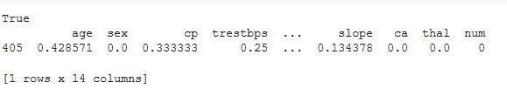
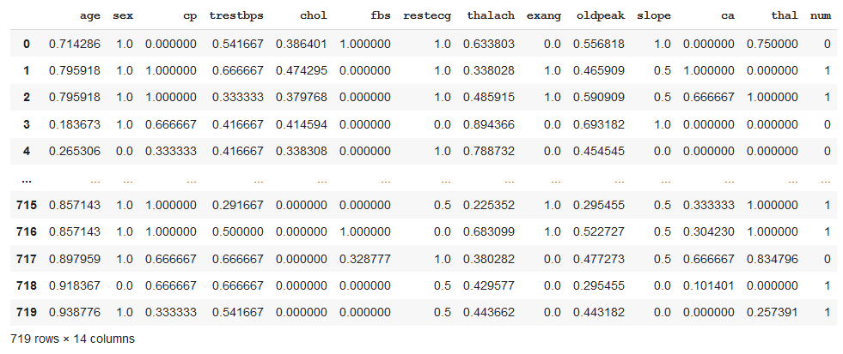
Analysis of the Imputed dataset (Final Dataset) continued...
Dataset was checked for duplicate rows
Duplicate row was removed, and the final dataset is as follows:

Slide 19
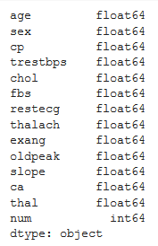
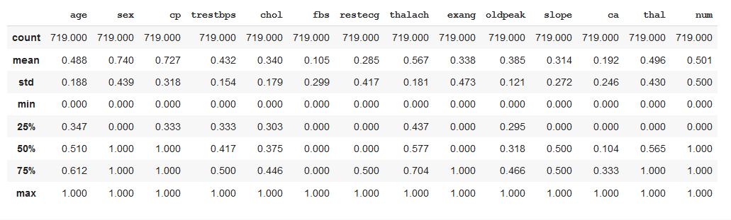
Analysis of the Imputed dataset (Final Dataset) continued...
Further Descriptive Analysis of the Final dataset was performed.
Data Type
Descriptive Statistics

Slide 20
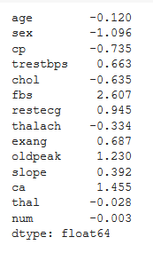
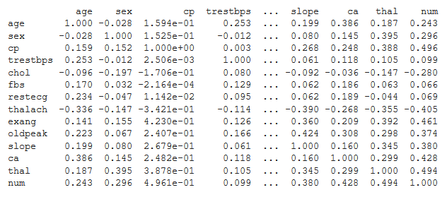
Analysis of the Imputed dataset (Final Dataset) continued...
Further Descriptive Analysis continued...
Correlation
Skewness

Slide 21
Analysis of the Imputed dataset (Final Dataset) continued...
In order to produce more meaningful statistical inferences, visualization for descriptive statistics, correlation, and skewness were performed.
Unimodal Visualization: Histogram, Density Curve, and Box Plot
Multimodal Visualization: Scatter Plot and Correlation Matrix

Slide 22
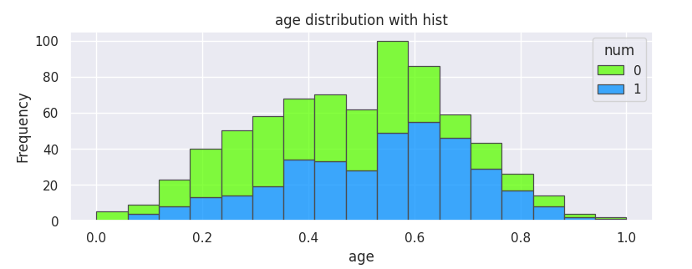
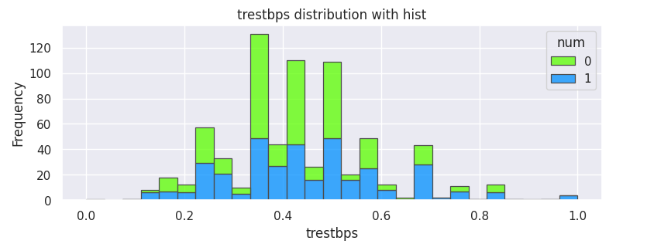
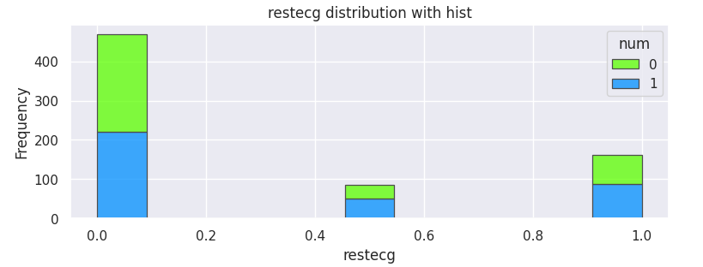
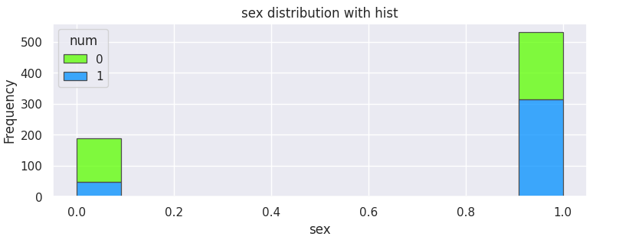
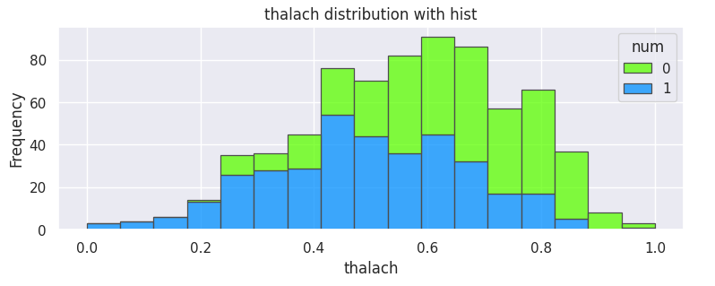
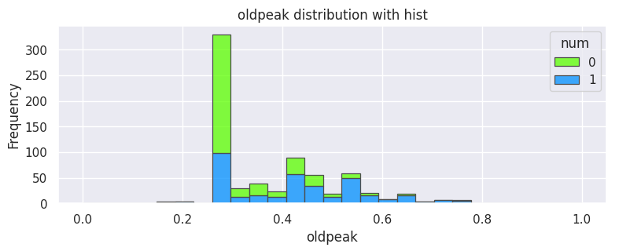
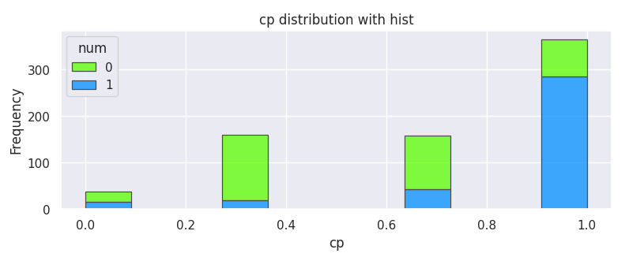
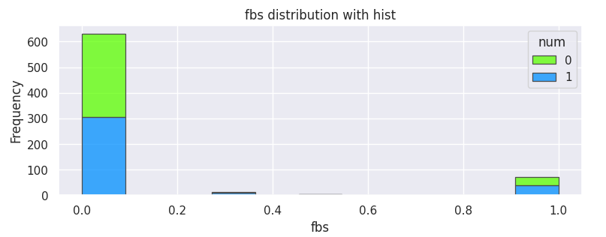
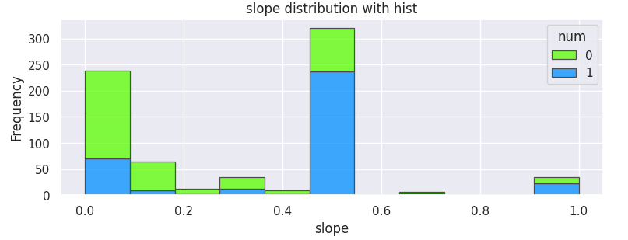
Analysis of the Imputed dataset (Final Dataset) continued...
Histograms for the attributes

Slide 23
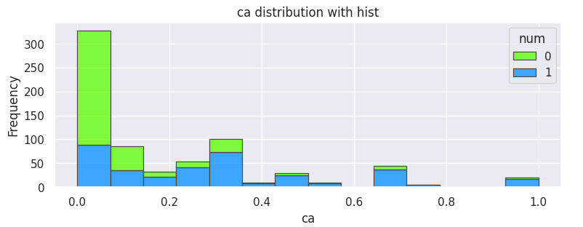
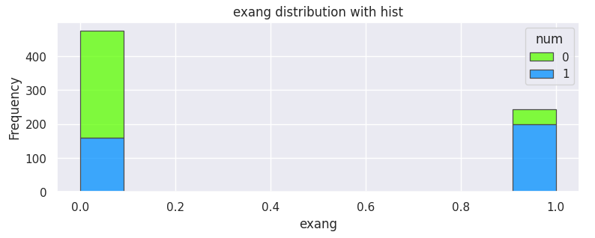
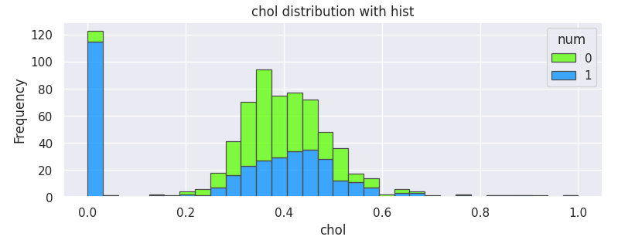
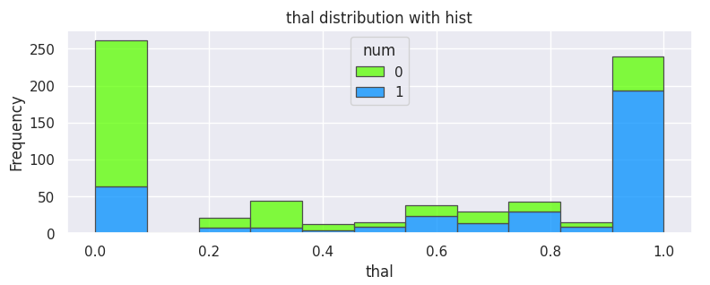
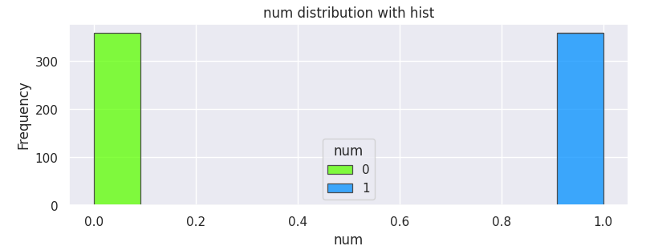
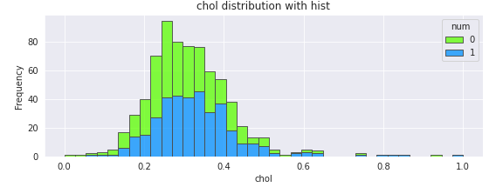
Analysis of the Imputed dataset (Final Dataset) continued...

Slide 24
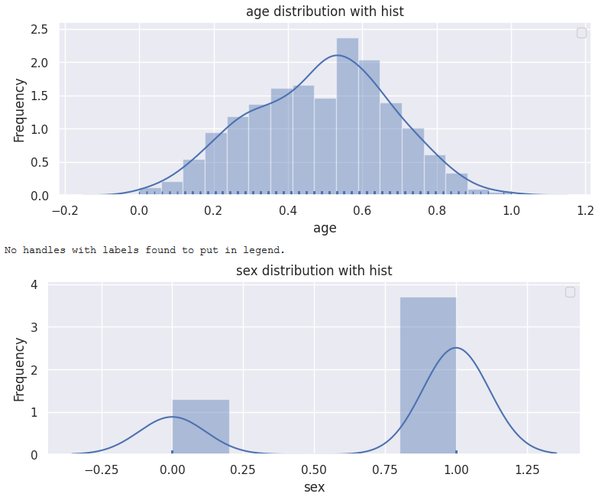
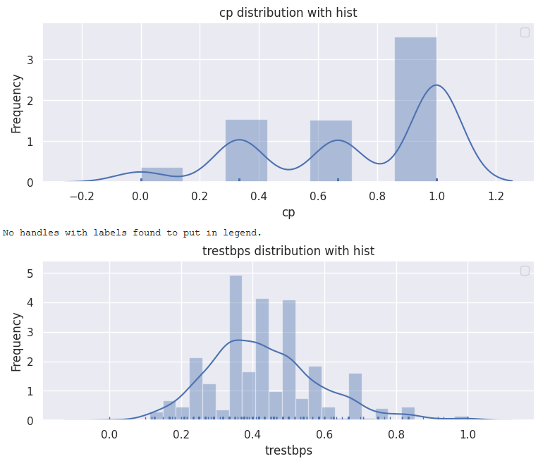
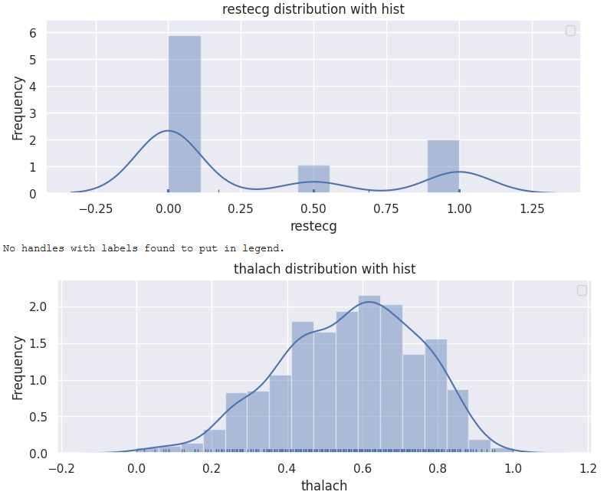
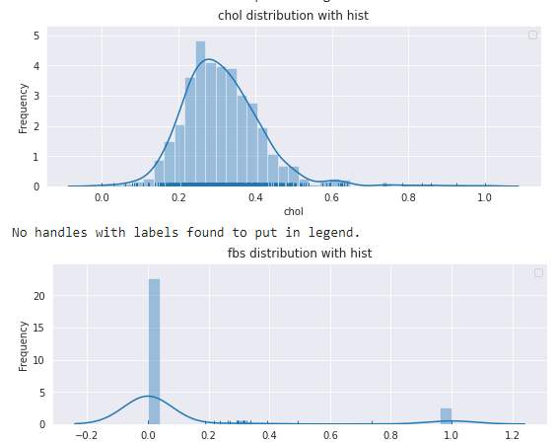
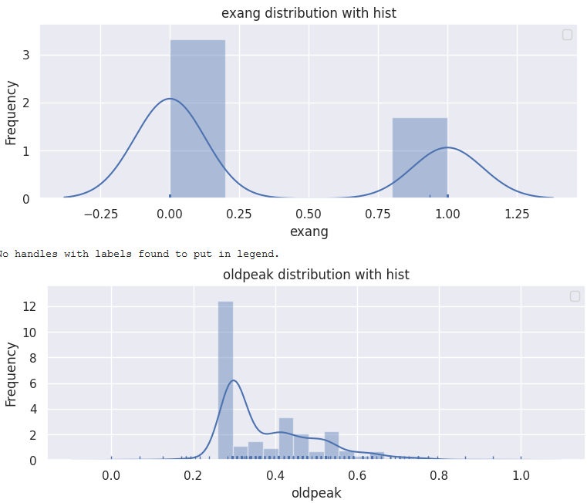
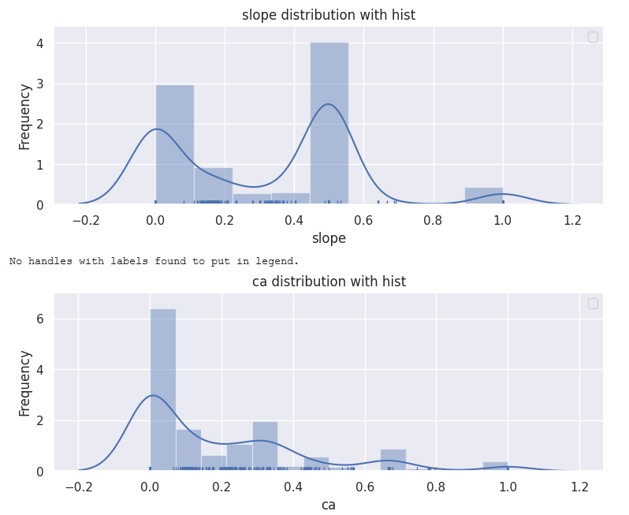
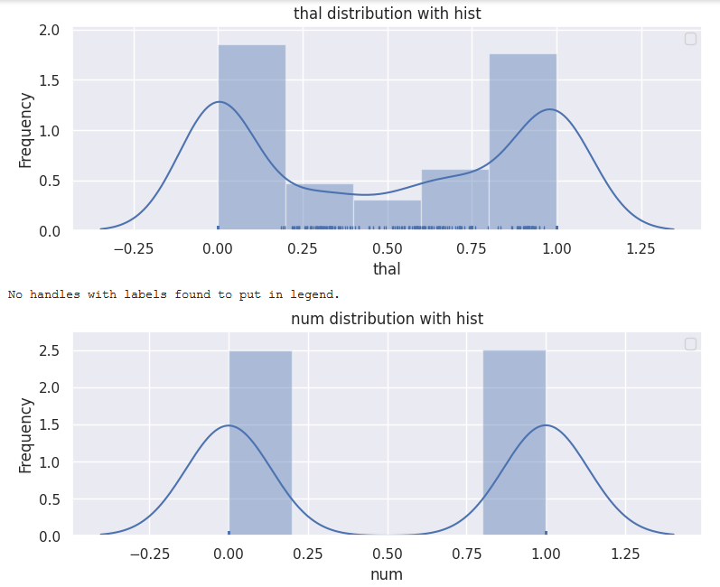
Analysis of the Imputed dataset (Final Dataset) continued...
Density curves for the attributes

Slide 25
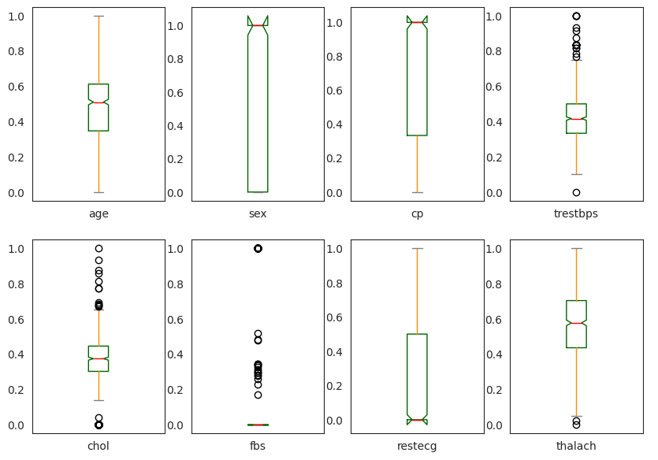
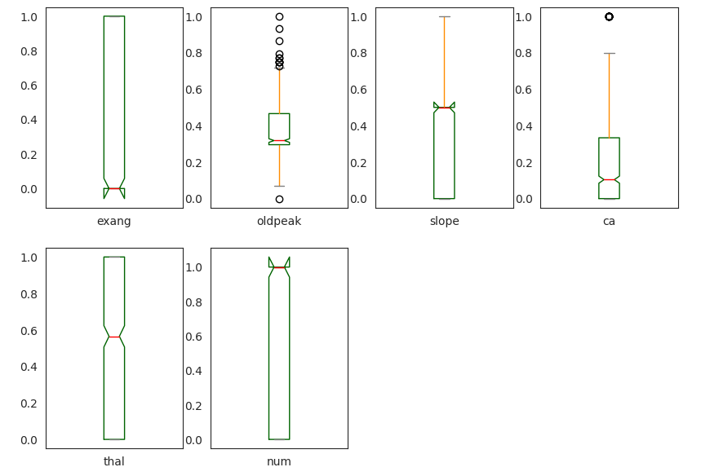
Analysis of the Imputed dataset (Final Dataset) continued...
Box Plots for the attributes

Slide 26
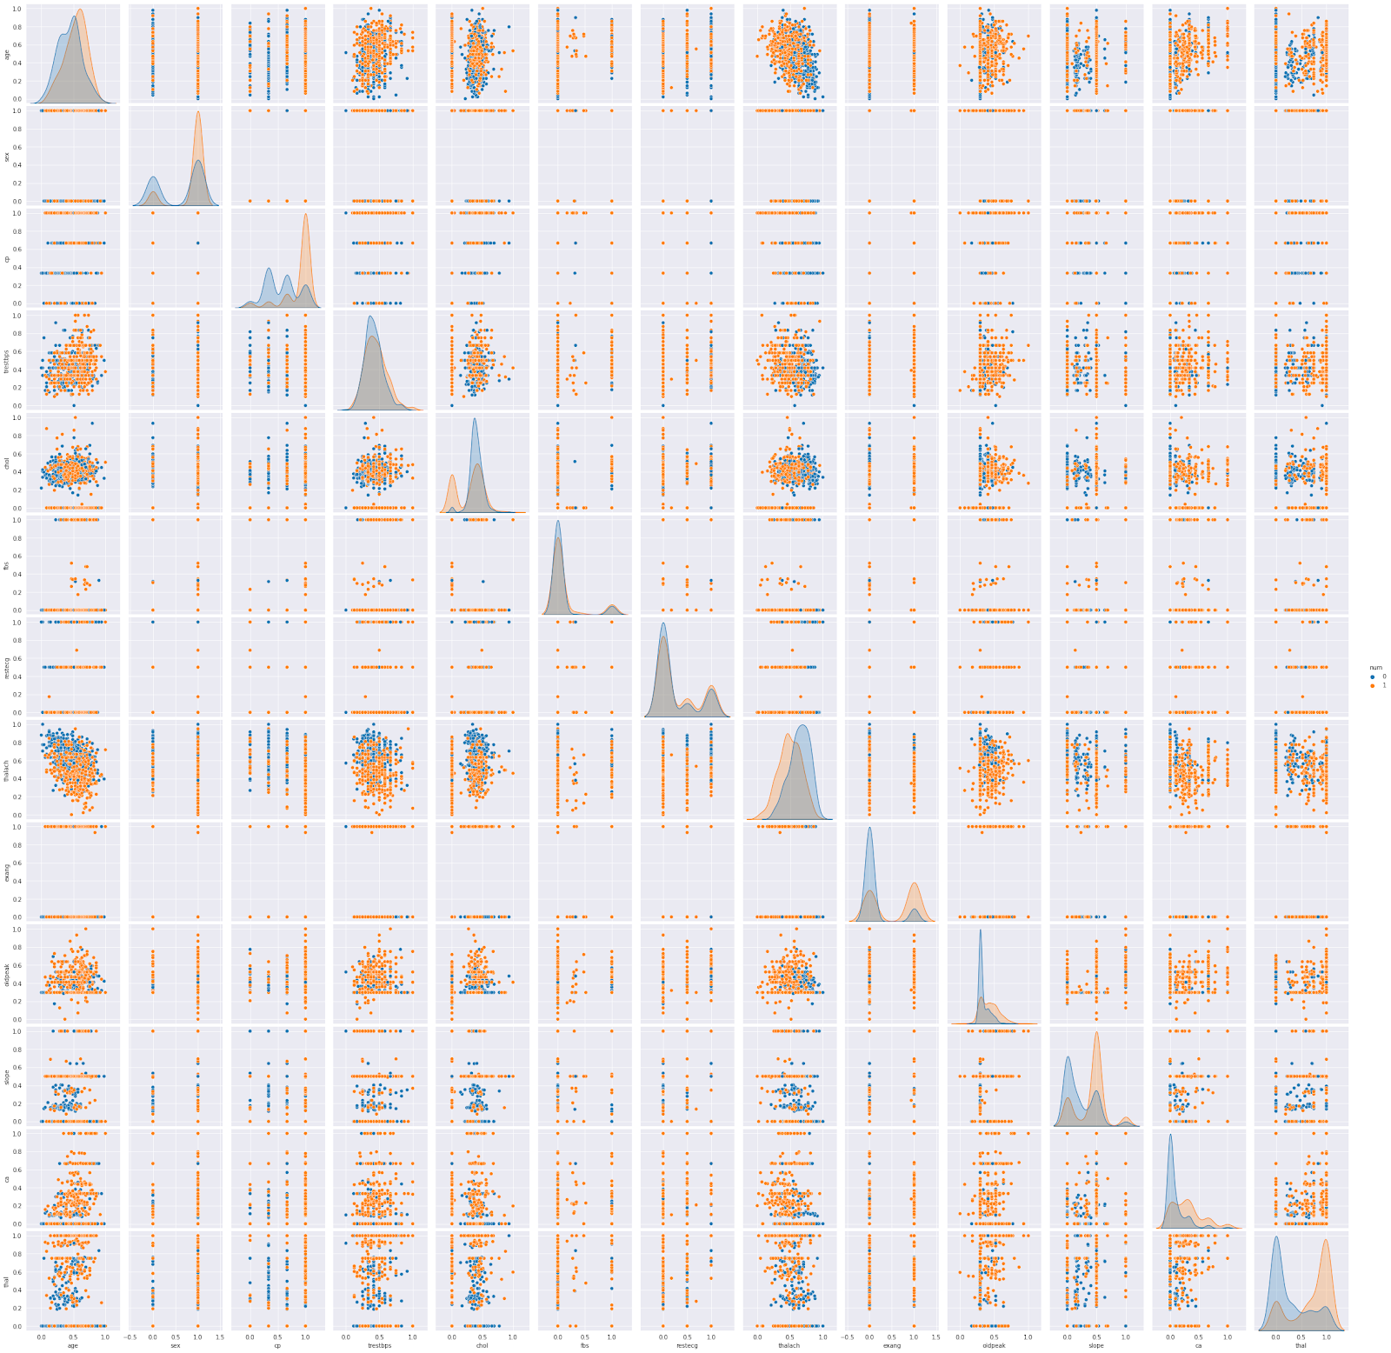
Analysis of the Imputed dataset (Final Dataset) continued...
Scatter Plot for the Multimodal Analysis

Slide 27

Analysis of the Imputed dataset (Final Dataset) continued...
Correlation Matrix for Multimodal Analysis

Slide 28
Analysis of the Imputed dataset (Final Dataset) continued...
Interpretation of Statistics and Visualizations
Some of the quantitative attributes were skewed. Standardizing the data might produce better results.
Some of the variables had outliers, although we decided not to remove the outliers since the data is concerned with the medical and field and the outliers could work in our favor.
A strong correlation between the output variable num and input variables: thal, ca, slope, oldpeak, exang, thalach, cp, and sex indicated that these predictors could produce favorable results.

Slide 29
Analysis of the Imputed dataset (Final Dataset) continued...
Interpretation of Statistics and Visualizations
After the analysis, a few questions were formulated:
Would fewer predictors rather than all the predictors in classifying the presence of heart disease produce a more accurate result?
If yes, which predictors are the best?
Are the predictors controllable?

Slide 30
Baseline Models
At this point, we decided to use all the predictors to build the Baseline Models
Data was split : 70% Training, 30% Testing
Considered Algorithms:
Logistic Regression
KNN Classifier
Support Vector Machine
Random Forest Classifier
Ada Boosting
Decision Tree Classifier
Bagging Classifier
XG Boosting
Linear Discriminant Analysis
Naive Bayes

Slide 31

Baseline Models
Performance measures for the models:
Accuracy
AUC
Confusion Matrix
Variable Importance
Log loss
Precision
F-1 Score
R-Square
Based on the findings above, the results indicated that XG Boosting, RandomForest, Ada Boosting, KNN Classifier, and SVM were performing in the most effective manner and producing the best results.

Slide 32
Future Work :
Apply the feature selection on the base models.
Try different combinations on the best performing baseline models for feature selection to improve accuracy.
Apply the hyperparameter tuning on the models using GridSearch/Gradient Descent.
Blending and stacking the models using ensembles to assess any possible gains.

